Slide 1

Shaders
ESTONIA
Basic principles of shaders with OPENGL ES 2.0 in WebGL 1.0
Daniel Priori – Derivco Estonia

Slide 2
Shaders BASIC PRINCIPLES OF SHADERS WITH OPENGL ES 2.0 IN WEBGL 1.0
Download the package: https://goo.gl/vxRB9X
Presentation
Basics of Shaders and some things in particular for OpenGL ES 2.0
Break
~15 minutes
Workshop (let’s code something!)
We will focus on create direct shader programs without adding code for shader compilation steps (WebGL steps. Because PIXI/ThreeJS or other Engines will do this for us ☺).
Cherry

Slide 3
Shaders BASIC PRINCIPLES OF SHADERS WITH OPENGL ES 2.0 IN WEBGL 1.0
So, what exactly are shaders?
In OpenGL ES 2.0 (for WebGL 1.0) are a form of pairs of functions with the purpose of change and rasterizing (based on the code you supply) the points, lines, triangles and colors.

Slide 4
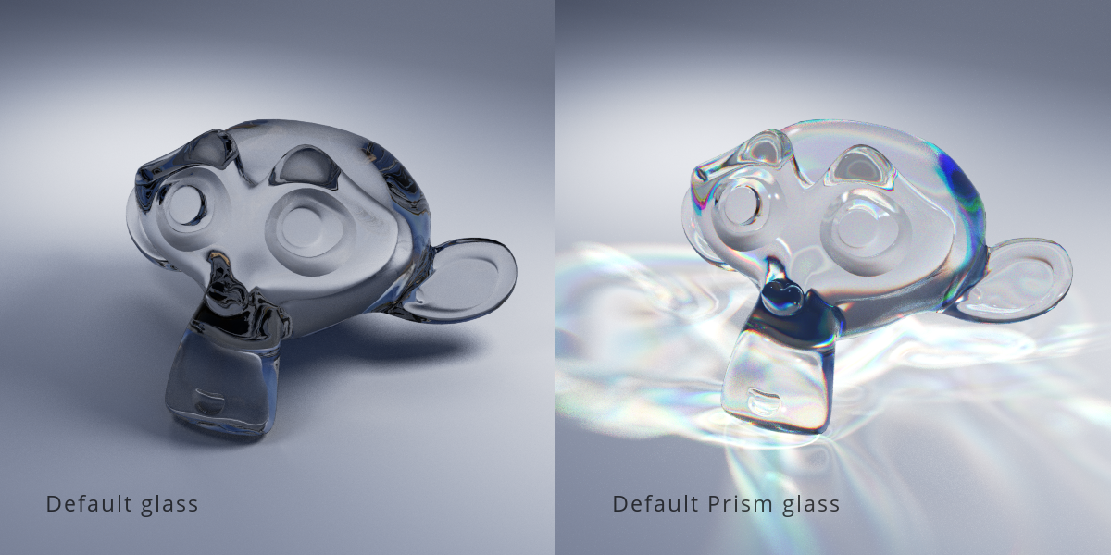
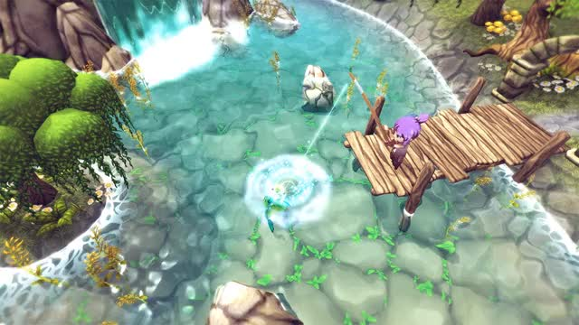
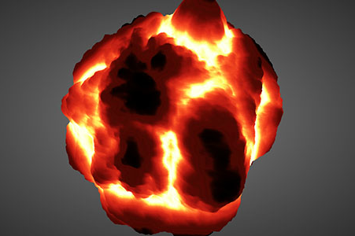
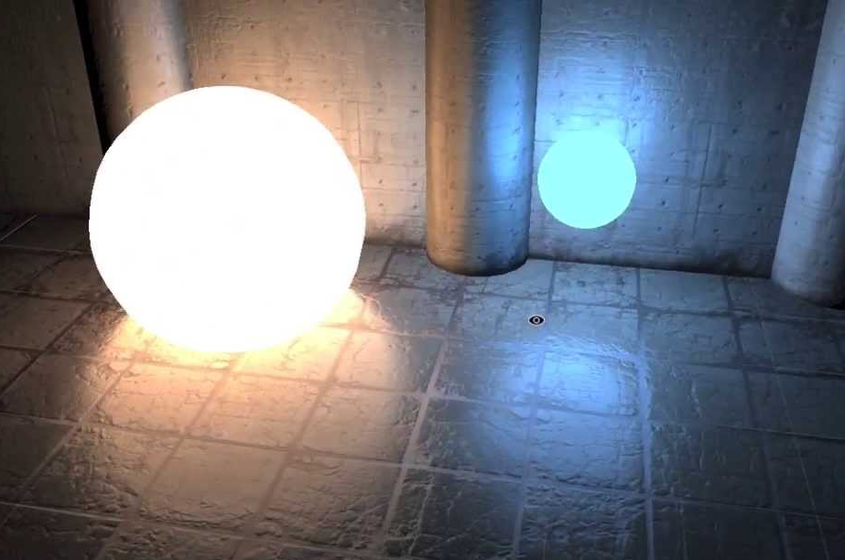
Shaders BASIC PRINCIPLES OF SHADERS WITH OPENGL ES 2.0 IN WEBGL 1.0
https://blendermarket.com/products/prism---fast--advanced-glass-shader-for-cycles
http://staggart.xyz/unity/stylized-water-shader/
https://www.clicktorelease.com/blog/vertex-displacement-noise-3d-webgl-glsl-three-js/
Shader Forge for Unity https://www.assetstore.unity3d.com/#!/content/14147
Shader Forge for Unity https://www.assetstore.unity3d.com/#!/content/14147
Shader Forge for Unity https://www.assetstore.unity3d.com/#!/content/14147

Slide 5
Shaders BASIC PRINCIPLES OF SHADERS WITH OPENGL ES 2.0 IN WEBGL 1.0
So, what exactly are shaders?
2 things we need to care about:
clipspace coordinates
colors.
Part of objects will be clipped
Camera
Space visible
frustum
Clipspace
frustum
Eye

Slide 6
Shaders BASIC PRINCIPLES OF SHADERS WITH OPENGL ES 2.0 IN WEBGL 1.0
So, what exactly are shaders?
How to insert those information?
By code – vertex shader – clipspace coordinates
By code – fragment shader – color.

Slide 7
Shaders BASIC PRINCIPLES OF SHADERS WITH OPENGL ES 2.0 IN WEBGL 1.0
So, what exactly are shaders?
Those 2 functions are each written in a very strictly typed C/C++ like language called GLSL (GL Shader Language).

Slide 8
Shaders BASIC PRINCIPLES OF SHADERS WITH OPENGL ES 2.0 IN WEBGL 1.0
So, what exactly are shaders?
Programs → override the existing implementation of:
per-vertex and
per-pixel
behavior handled by the processor on screen.

Slide 9
Shaders BASIC PRINCIPLES OF SHADERS WITH OPENGL ES 2.0 IN WEBGL 1.0
HLSL, the High Level Shading Language
Microsoft
DirectX 8+
Cg
Nvidia
GLSL, the OpenGL Shading Language
Khronos Group
3D graphics, Virtual and Augmented Reality, Parallel Computing, Neural Networks, and Vision Processing
Members: AMD, 3DLab, Apple, Google, Epic Games, Nvidia, etc.

Slide 10
Shaders BASIC PRINCIPLES OF SHADERS WITH OPENGL ES 2.0 IN WEBGL 1.0
OpenGL shaders give the user control over each
vertex
fragment (each pixel or partial pixel) interpolated between vertices.

Slide 11
Shaders BASIC PRINCIPLES OF SHADERS WITH OPENGL ES 2.0 IN WEBGL 1.0
PixiJS / ThreeJS...
SCREEN
Shader code
GPU
WebGL

Slide 12
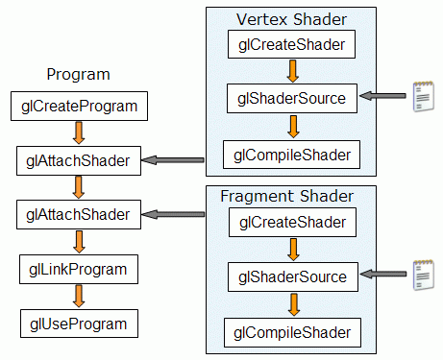
Shaders BASIC PRINCIPLES OF SHADERS WITH OPENGL ES 2.0 IN WEBGL 1.0
Source: http://www.lighthouse3d.com - opengl-setup-for-glsl

Slide 13
Shaders BASIC PRINCIPLES OF SHADERS WITH OPENGL ES 2.0 IN WEBGL 1.0
CPU
Vertex Data
Your CPU Program
we
override
Vertex shaders
Vertex Processing
local world clipspace
Primitive Assembly
triangles lines points
GPU
Rasterization
multisampling and smoothing
we
override
Fragment shaders
Fragment Processing
textures alpha depth
Screen (pixels)
Framebuffer
Notes:
OpenGL shaders give the user control over each vertex and each fragment (each pixel or partial pixel) interpolated between vertices.
First, we pass from CPU Program to the Vertex Processing where the GPU starts to process the position of each vertice in local position, in word and starts to process the clipspace.
After, we have the primitive Assembly where each vertice is connected to others that need to connect creating triangles, lines and the points.
After vertices are processed, polygons are rasterized. During rasterization, values like position, color, depth, and others are interpolated across the polygon. The interpolated values are passed to each pixel fragment.

Slide 14
Shaders BASIC PRINCIPLES OF SHADERS WITH OPENGL ES 2.0 IN WEBGL 1.0
Code structure inside shader
Precision and variable declaration (with the [qualifier] [precision] and type)
precision highp float
attribute vec3 vertexPosition;
uniform lowp float time;
Functions (custom functions)
float calcShadowEffect(vec3 ambientLight){…}
Main Function (main() the last function inside code)
void main(){ gl_FragColor = vec4(.... }

Slide 15
Shaders BASIC PRINCIPLES OF SHADERS WITH OPENGL ES 2.0 IN WEBGL 1.0
Basic types
void → no function return value or empty parameter list
bool → Boolean
int → signed integer
float → floating scalar
vec2, vec3, vec4 → n-component floating point vector
bvec2, bvec3, bvec4 → Boolean vector
ivec2, ivec3, ivec4 → signed integer vector
mat2, mat3, mat4 → 2x2, 3x3, 4x4 float matrix
sampler2D → access a 2D texture
samplerCube → access cube mapped texture

Slide 16
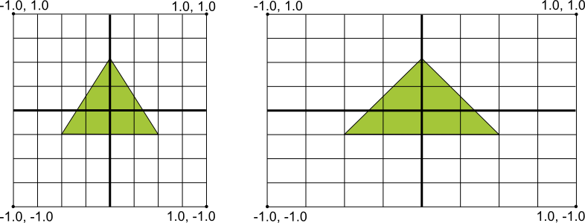
Shaders BASIC PRINCIPLES OF SHADERS WITH OPENGL ES 2.0 IN WEBGL 1.0
Coordinates
Source: https://stuff.mit.edu/afs/sipb/project/android/docs/guide/topics/graphics/opengl.html
Notes:
It's the responsibility of the vertex shader to make sure all vertices are transformed from their local coordinate systems to the correct viewport coordinates. Anything outside the viewport dimensions is skipped and is not drawn altogether

Slide 17
Shaders BASIC PRINCIPLES OF SHADERS WITH OPENGL ES 2.0 IN WEBGL 1.0
Structures and arrays
Structure
Array
structures and blocks can be arrays
only 1-dimensional arrays supported
structure members can be arrays
struct Light {
vec4 position;
vec4 ambient;
float attenuation;
};
uniform Light lights[numLights];
float elements[42];

Slide 18
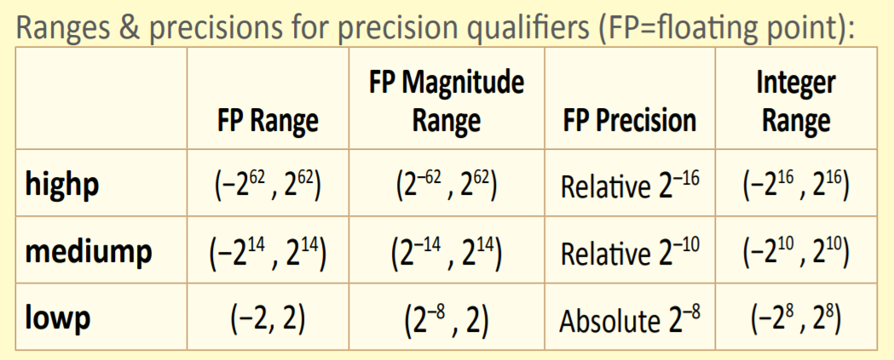
Shaders BASIC PRINCIPLES OF SHADERS WITH OPENGL ES 2.0 IN WEBGL 1.0
Precision
highp
mediump
lowp
precision highp float; // all float in highp
lowp float color;
highp mat4 someMatrix;
varying mediump vec2 v_someCoordinates;
uniform lowp vec3 u_effectValues;
Source: WebGL Khronos Group Card
Notes:
Any floating point, integer, or sampler declaration can have the type preceded by one of these precision qualifiers:

Slide 19
Shaders BASIC PRINCIPLES OF SHADERS WITH OPENGL ES 2.0 IN WEBGL 1.0
Some bult-in functions →
pow()
exp()
radians()
degrees()
sin()
cos()
dot()
clamp()
texture2D()
normalize()
Many others (see WebGL Card from Khronos Group)

Slide 20
Shaders BASIC PRINCIPLES OF SHADERS WITH OPENGL ES 2.0 IN WEBGL 1.0
Vertex shader
Fragment shader

Slide 21
Shaders BASIC PRINCIPLES OF SHADERS WITH OPENGL ES 2.0 IN WEBGL 1.0
Vertex shader
Are run once for each vertex given to the graphics processor.
Transform each vertex's 3D position in virtual space to the 2D coordinate.
Vertex shaders can manipulate
position,
texture coordinate.
Cannot create new vertices.
Output of the vertex shader goes to the next stage in the pipeline →
geometry shader if present or the rasterizer otherwise.
Notes:
Are run once for each vertex given to the graphics processor.
The purpose is to transform each vertex's 3D position in virtual space to the 2D coordinate at which it appears on the screen.
Vertex shaders can manipulate properties such as
position,
texture coordinate.
But cannot create new vertices.
Output of the vertex shader goes to the next stage in the pipeline, which is either a geometry shader if present¹ or the rasterizer otherwise.
1. Geometry shaders are a relatively new type of shader. It can generate new graphics primitives, such as points, lines, and triangles, from those primitives that were sent to the beginning of the graphics pipeline. Geometry shader programs are executed after vertex shaders. Since OpenGL 3.2 (and not in WebGL 1.0 or 2.0)

Slide 22
Shaders BASIC PRINCIPLES OF SHADERS WITH OPENGL ES 2.0 IN WEBGL 1.0
Fragment shader
Or Pixel Shader, compute color and other attributes of each fragment (each pixel or partial pixel).
Fragment shaders range from always outputting:
same color,
applying a lighting value,
bump mapping,
shadows,
specular highlights,
translucency and other phenomena.

Slide 23
Shaders BASIC PRINCIPLES OF SHADERS WITH OPENGL ES 2.0 IN WEBGL 1.0
Fragment shader
They can alter the depth of the fragment (for Z-buffering), or output more than one color if multiple render targets are active.
In 3D graphics, a fragment shader alone cannot produce very complex effects.
Notes:
In 3D graphics, a fragment shader alone cannot produce very complex effects, because it operates only on a single fragment, without knowledge of a scene's geometry.

Slide 24
Shaders BASIC PRINCIPLES OF SHADERS WITH OPENGL ES 2.0 IN WEBGL 1.0
Four storage qualifiers of shader parameter
Const
Compile-time constant or read-only function parameters
Attribute
Set per vertex - comes from outside shaders (your CPU program or framework) or defined by OpenGL engine.
Only in vertex shader.
Ex.: position, color, texture coordinate(s)
Uniform
Set throughout execution. Global parameter.
Ex.: Model-View-Projection Matrix, time, ambient light.
Varying
Passed from vertex shader to fragment shader.
Per-vertex values to be interpolated (across connected vertices) for the fragment shader
Attributes
Vertex
Processor
Uniform
params
Varying
params
Fragment
Processor

Slide 25
Shaders BASIC PRINCIPLES OF SHADERS WITH OPENGL ES 2.0 IN WEBGL 1.0
Position (gl_Position)
Final vertex position transformed into clipping space
PointSize (gl_PointSize)
Size of point sprite (only used when rendering point sprites)
ModelViewProjection Matrix
Lighting
etc…
Vertex
Processor
Color
Normal
Position
Texture coord
etc…
Texture data
Varyings
Per-vertex values to be interpolated for the fragment shader
Custom variables
Per-vertex attributes

Slide 26
Shaders BASIC PRINCIPLES OF SHADERS WITH OPENGL ES 2.0 IN WEBGL 1.0
ModelViewProjection Matrix
Material
Lighting
etc…
Fragment color (gl_FragColor)
Final fragment color to be rendered when only one render target is used
Fragment colors multiple renders (gl_FragData[])
Final fragment colors to be rendered when multiple render targets are used
Fragment
Processor
Color
Texture coords
Fragment coords
Front facing
Texture data
Custom variables
Varying (from vertex shader)

Slide 27
Shaders BASIC PRINCIPLES OF SHADERS WITH OPENGL ES 2.0 IN WEBGL 1.0
Let’s talk about:
Varying
Normal map
Model View Projection Matrix
Uv coordinates
Maks for coordinates

Slide 28
Shaders BASIC PRINCIPLES OF SHADERS WITH OPENGL ES 2.0 IN WEBGL 1.0
varying vec4 v_vertexColor; attribute vec4 a_vertexPosition;
void main()
{
v_vertexColor = vec4(a_vertexPosition.xy * 0.5, a_vertexPosition.zw * 0.2); gl_Position = a_vertexPosition;
}
One thing about Varying
Vertex shader
Compute vertex_color
varying vec4 v_vertexColor; // from vertex shader
void main()
{
gl_FragColor = v_vertexColor;
}
Get interpolated
vertex_color
Fragment shader
gl_FragColor

Slide 29
Shaders BASIC PRINCIPLES OF SHADERS WITH OPENGL ES 2.0 IN WEBGL 1.0
One thing about Normal Map

Slide 30
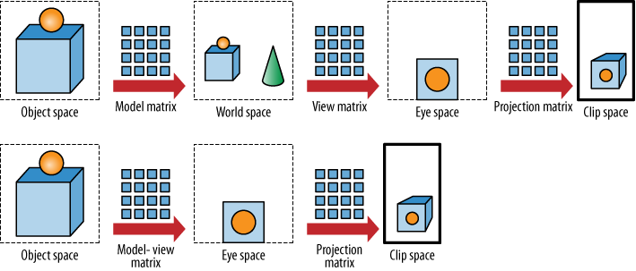
Shaders BASIC PRINCIPLES OF SHADERS WITH OPENGL ES 2.0 IN WEBGL 1.0
One thing about Model-View-Projection Matrix
Source: https://www.safaribooksonline.com/library/view

Slide 31
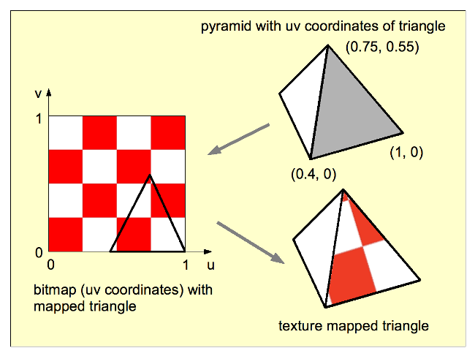
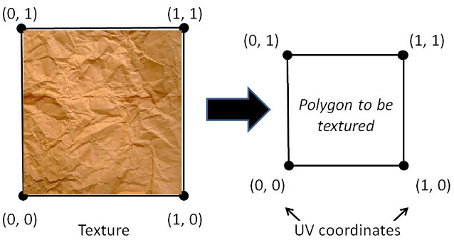
Shaders BASIC PRINCIPLES OF SHADERS WITH OPENGL ES 2.0 IN WEBGL 1.0
One thing about UV coordinates
Source: http://www.c-jump.com/bcc/common/Talk3/OpenGL/Wk07_texture/Wk07_texture.html

Slide 32
Shaders BASIC PRINCIPLES OF SHADERS WITH OPENGL ES 2.0 IN WEBGL 1.0
One thing about masks for coordinates
XYZW, STPQ, or RGBA
Common name for texture coordinates are:
U and V.
Then came 3D Textures and should be used for 3D textures the W letter.
That causes a conflict with position:
X, Y, Z, and W.
To avoid such conflicts, OpenGL's convention is that the components of texture coordinates are named S, T, and R.
Came GLSL and this swizzle masks came around → conflicts with RGBA
So, they decided to use STPQ for textures coordinates.
XYZW, STPQ, or RGBA have the same origin.
But we cannot use position.xt
Notes:
XYZW, STPQ, or RGBA
Common name for texture coordinates are:
U and V.
Then came 3D Textures and should be used for 3D textures the W letter.
That causes a conflict with the names of the components of a position:
X, Y, Z, and W.
To avoid such conflicts, OpenGL's convention is that the components of texture coordinates are named S, T, and R.
But later on came GLSL and this swizzle masks came around. So, created conflicts with RGBA
So, they decided to use STPQ for textures coordinates.
But XYZW, STPQ, or RGBA have the same origin.
However, we cannot switch between masks. For example: we cannot use position.xt

Slide 33
Shaders BASIC PRINCIPLES OF SHADERS WITH OPENGL ES 2.0 IN WEBGL 1.0
References to follow
https://www.khronos.org/files/webgl/webgl-reference-card-1_0.pdf
http://www.opengl-tutorial.org/
https://thebookofshaders.com/

Slide 34

Shaders BASIC PRINCIPLES OF SHADERS WITH OPENGL ES 2.0 IN WEBGL 1.0
Let’s try!

Slide 35

Shaders BASIC PRINCIPLES OF SHADERS WITH OPENGL ES 2.0 IN WEBGL 1.0
Thank you!
https://80.lv/articles/unreal-engine-4-stylized-rendering-workflow/

